Slide 1
PYTHON PROGRAMMING
LAUNCHCODE
August 30, 2025
Asfand Khan

Slide 2
Questions + Homework Review
https://github.com/Asfandyar-Khan/LaunchCode/
Contains lectures
Powerpoint files
Google Colab
Contains homeworks
To be completed prior to class
Any unfinished or challenging questions are taken up at the start of class
Project must be picked by today
Any questions about last week’s homework?

Slide 3
Review of Past Class
Week 7 Homework Review
Review of Lists:
List methods:
.append() - adds items to an existing list
Index[] - allows for accessing of elements inside a list
Lists – Using them in Functions and For Loops
Tuples
How are they different from lists?

Slide 4
Today We Will Cover...
Week 8 Homework Review
Python Project Ideas – Finalization
Knowledge Check – List and Tuples
Knowledge Check – If Statement
Conditionals
Boolean expressions
If/Else statements
Chained conditionals
Dictionaries
What are they and why are they useful?
How do we use them in Python?

Slide 5
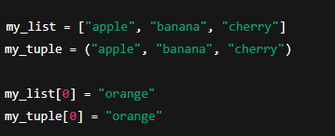
Knowledge Check – Lists vs Tuples
Question: Changing a List vs a Tuple
Look at the following code:
Which one will work, and which one will give an error?

Slide 6
Conditionals
Conditionals let your program make decisions and choose different paths!
If: The starting point – “if this condition is true, then do this”
elif: Short for “else if”. Checks another condition only if the previous one was false
else: “If none of the above conditions is true, then do this instead”

Slide 7
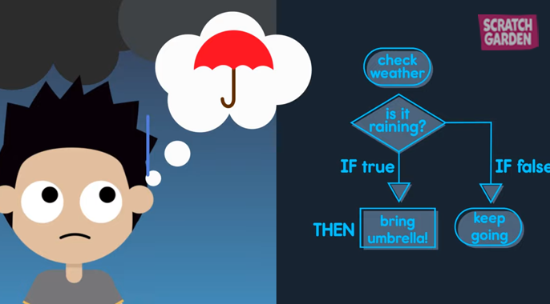
Conditionals – If/Else Statements

Slide 8
Conditionals – Comparison Operators
Conditions are built using comparison operators:
== (equal to)
!= (not equal to)
> (greater than)
< (less than)
>= (greater than or equal to)
<= (less than or equal to)

Slide 9
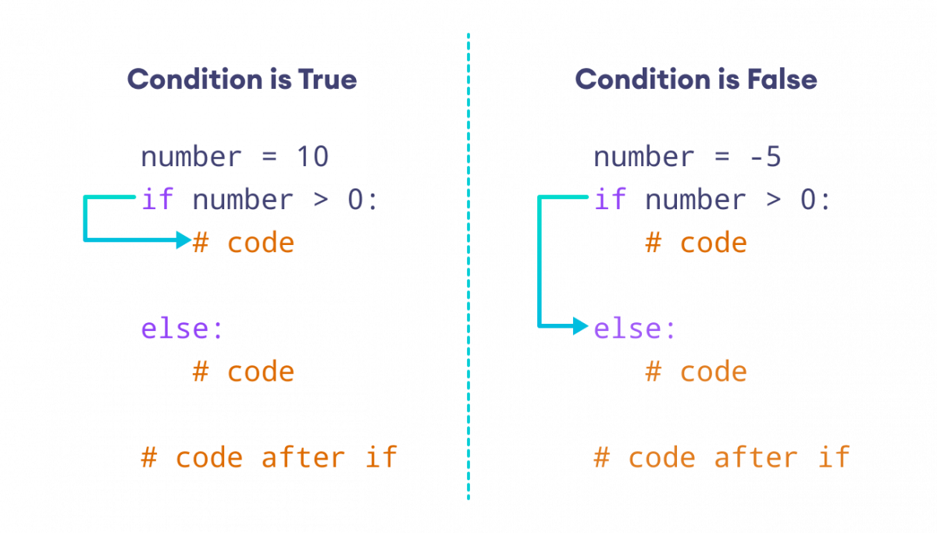
Conditionals – If/Else Syntax

Slide 10
Conditionals – If/Else Example
weather = "raining"
if weather == "sunny":
print("Wear sunglasses! 😎")
elif weather == "raining":
print("Don't forget your umbrella!☔")
else:
print("Have a great day! 🙂")
# This would print: "Don't forget your umbrella! ☔"

Slide 11
Knowledge Check – If Statement
Question: Weather Helper
You have a variable that stores today’s weather:
weather = “raining”
Write an if/elif/else statement so the program prints:
"Wear sunglasses!" if it’s sunny
"Bring an umbrella!" if it’s raining
"Have a great day!" otherwise
Hint: Start with if weather == "sunny":

Slide 12
Dictionaries – New Data Type
What are Dictionaries in Python?
A dictionary is like a real dictionary: it matches a word (key) to its definition (value)
In Python, dictionaries store data in pairs:
Key → like a label (e.g., "name").
Value → the information connected to that label (e.g., "Alice").
Keys must be unique (you can’t have two keys with the exact same name).
Dictionaries are written with curly braces { }.
Example: student = {"name": "Alice", "age": 12, "grade": "7th"}
What is a key and value in the above example?

Slide 13
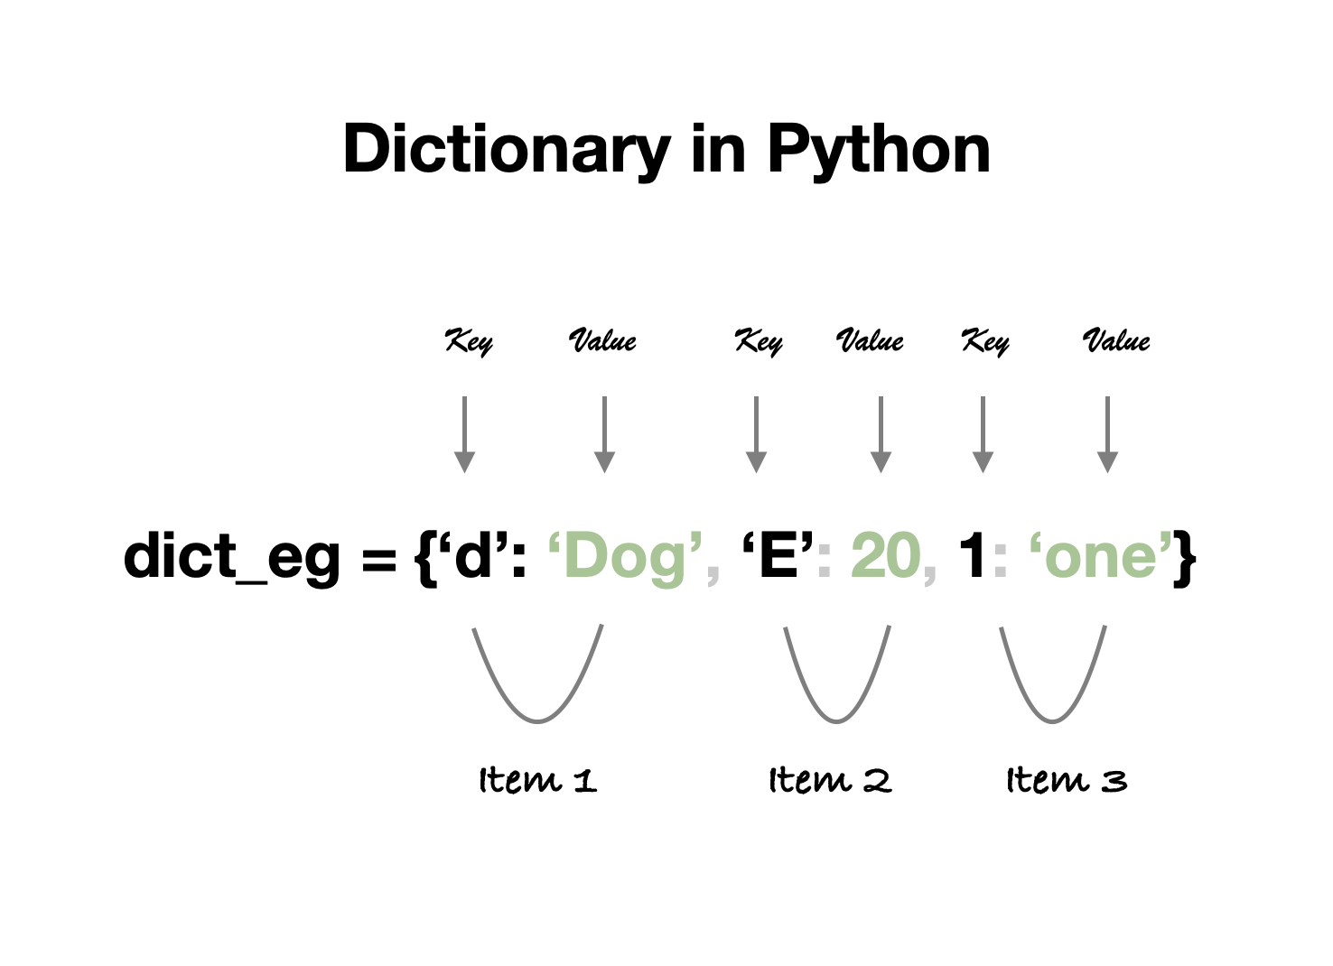

Slide 14
Dictionaries cont’d.
Why are Dictionaries Useful?
Organized storage → You can group related information together (like a profile).
Fast lookups → You can find data quickly using a key (instead of searching a whole list).
Flexible → Values can be numbers, strings, lists, or even other dictionaries!
Easy to update → You can change, add, or remove information easily.
Real-world use → Perfect for things like:
Storing a student’s info (name, age, grade).
Keeping track of game scores (player → points).
Making contact lists (name → phone number).

Slide 15
Review and Questions
Homework will be posted tomorrow!
Asfand Khan

